Slide 1
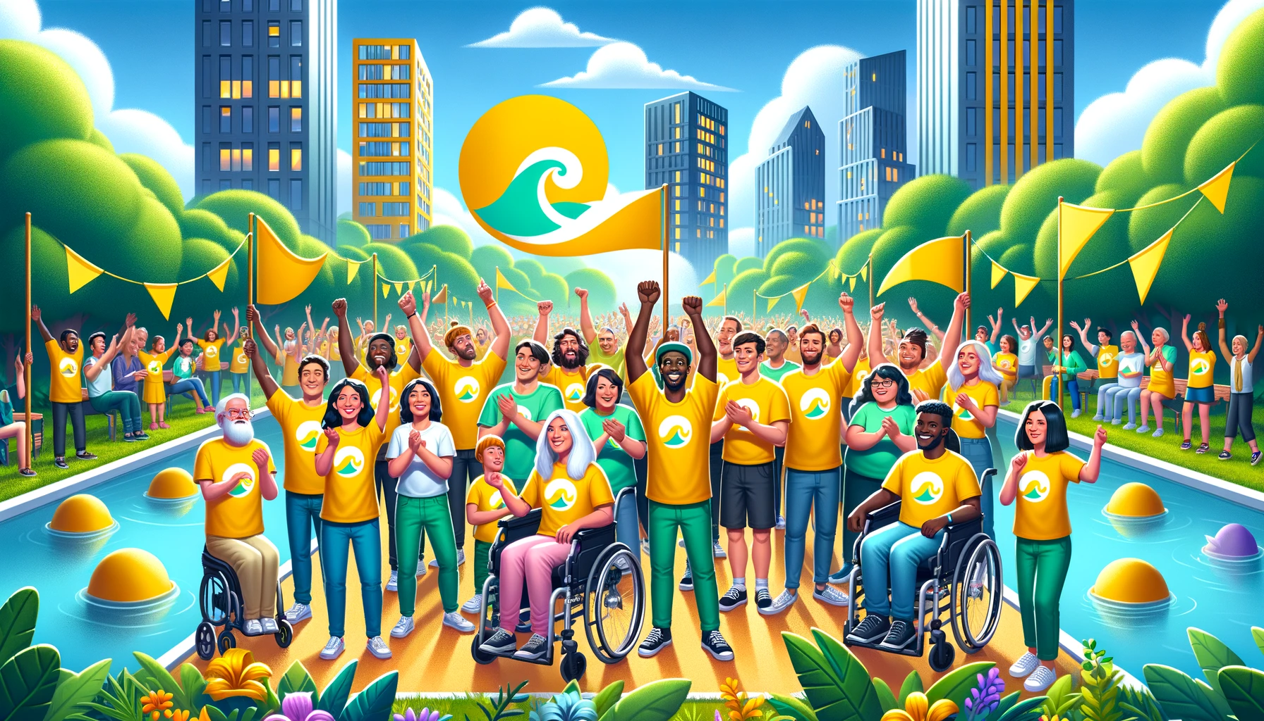
Green-Space Ease: Cultivating Accessible Greenspaces with our Mobile App
Team Yellow Wave: Esha, Moh, Ryan, and Lesi

Slide 2
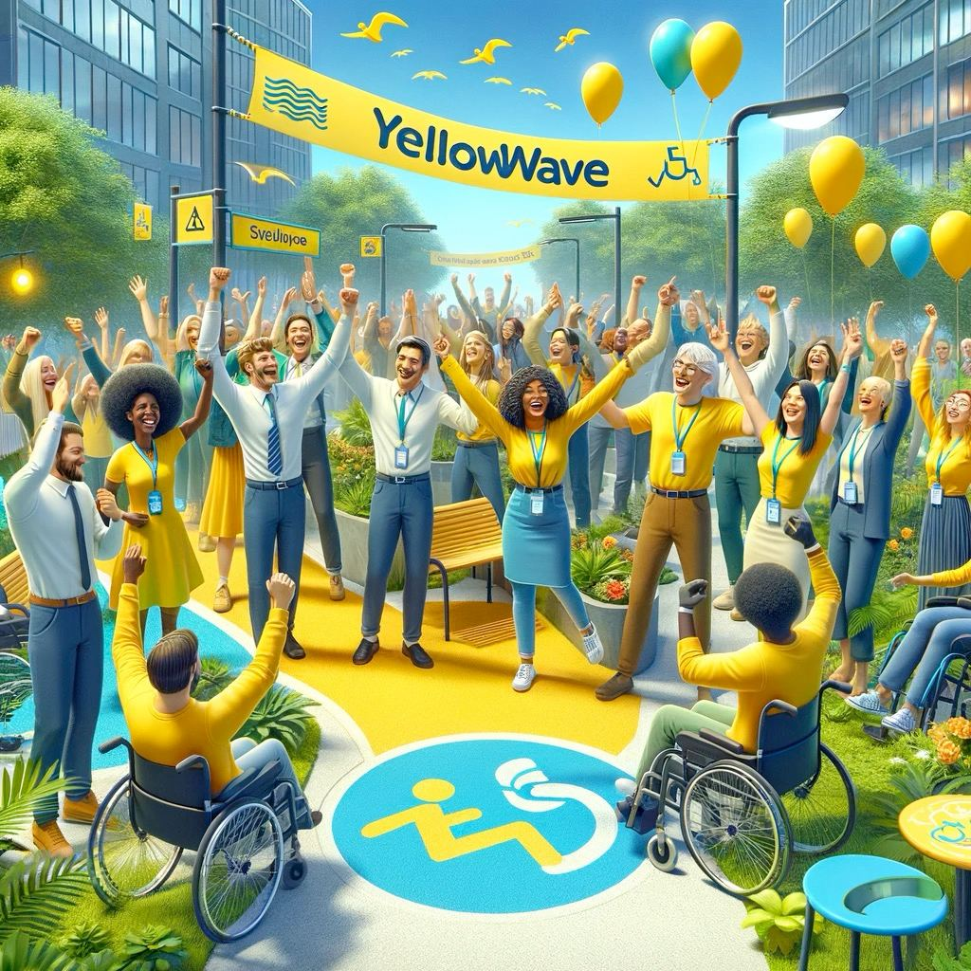
Agenda
Introduction of team
Project topic
Identification of problem/opportunity
Solution of problem
Demonstration of market fit
Identify competitors and collaborators
Risk assessment
User Feedback
Key metrics
Product road map

Slide 3

Introduction to the Team
Esha Shahid - Studying Business Administration majoring in Finance at SAIT
Moh B - Studying Education at the University of Winnipeg
Ryan Back - Studying Software Development at SAIT
Lesi N- Studying Information Systems Security at SAIT

Slide 4

Project Topic
The reason we chose good health and Well-being was because we collectively wanted to help out those struggling with mental health issues or have disabilities who are unable to participate in activities due to limited mobility.
Notes:
The reason we chose good health and Well-being was because we collectively wanted to help out those struggling with mental health issues or have disabilities who are unable to participate in activities due to limited mobility.

Slide 5
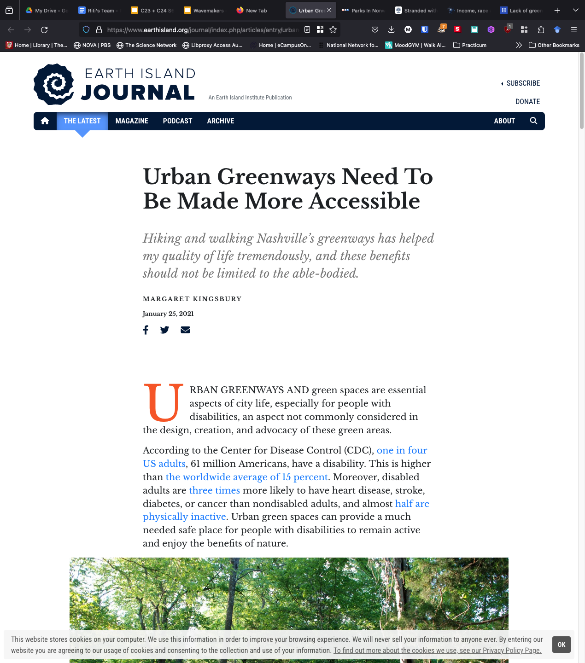
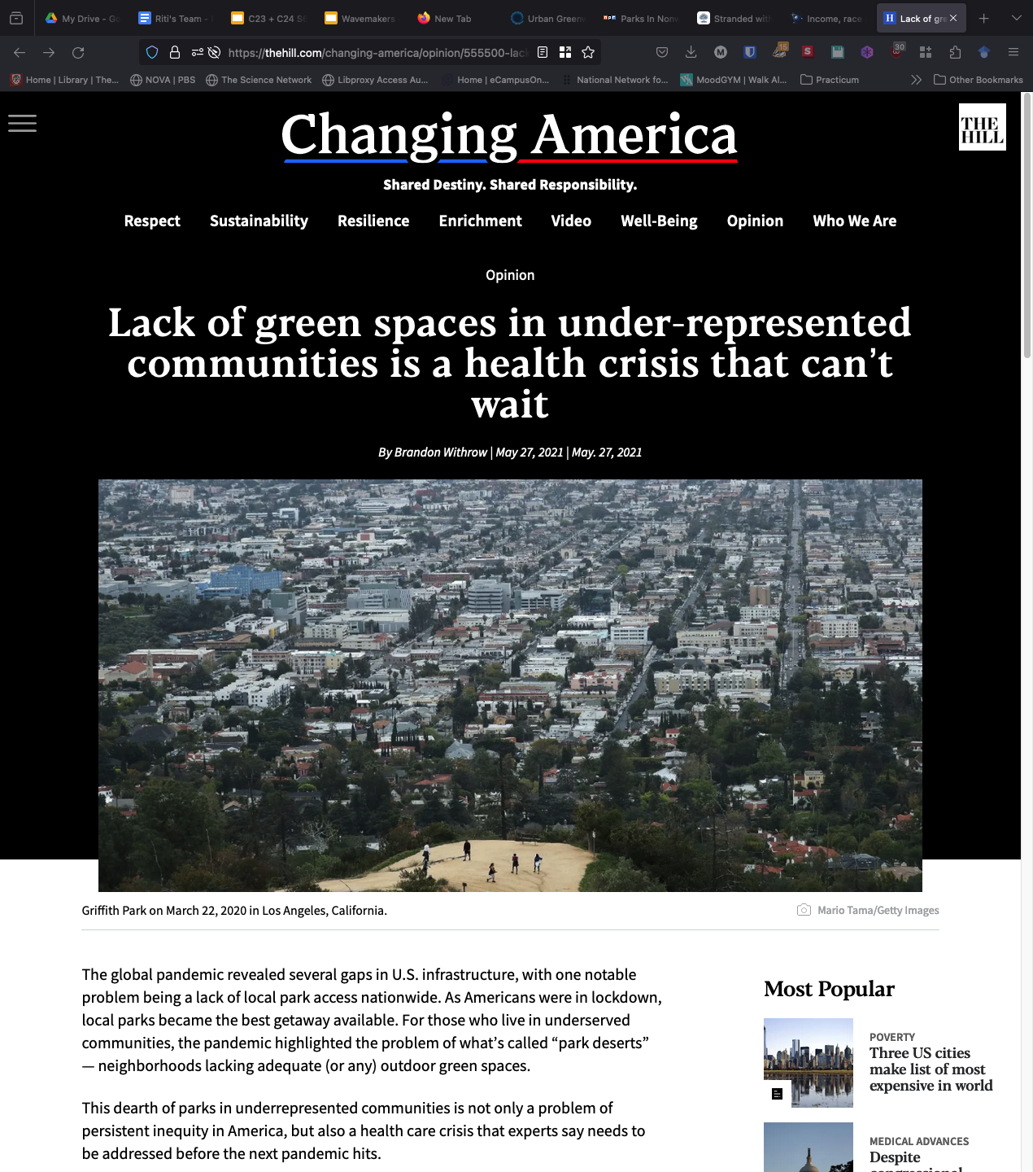
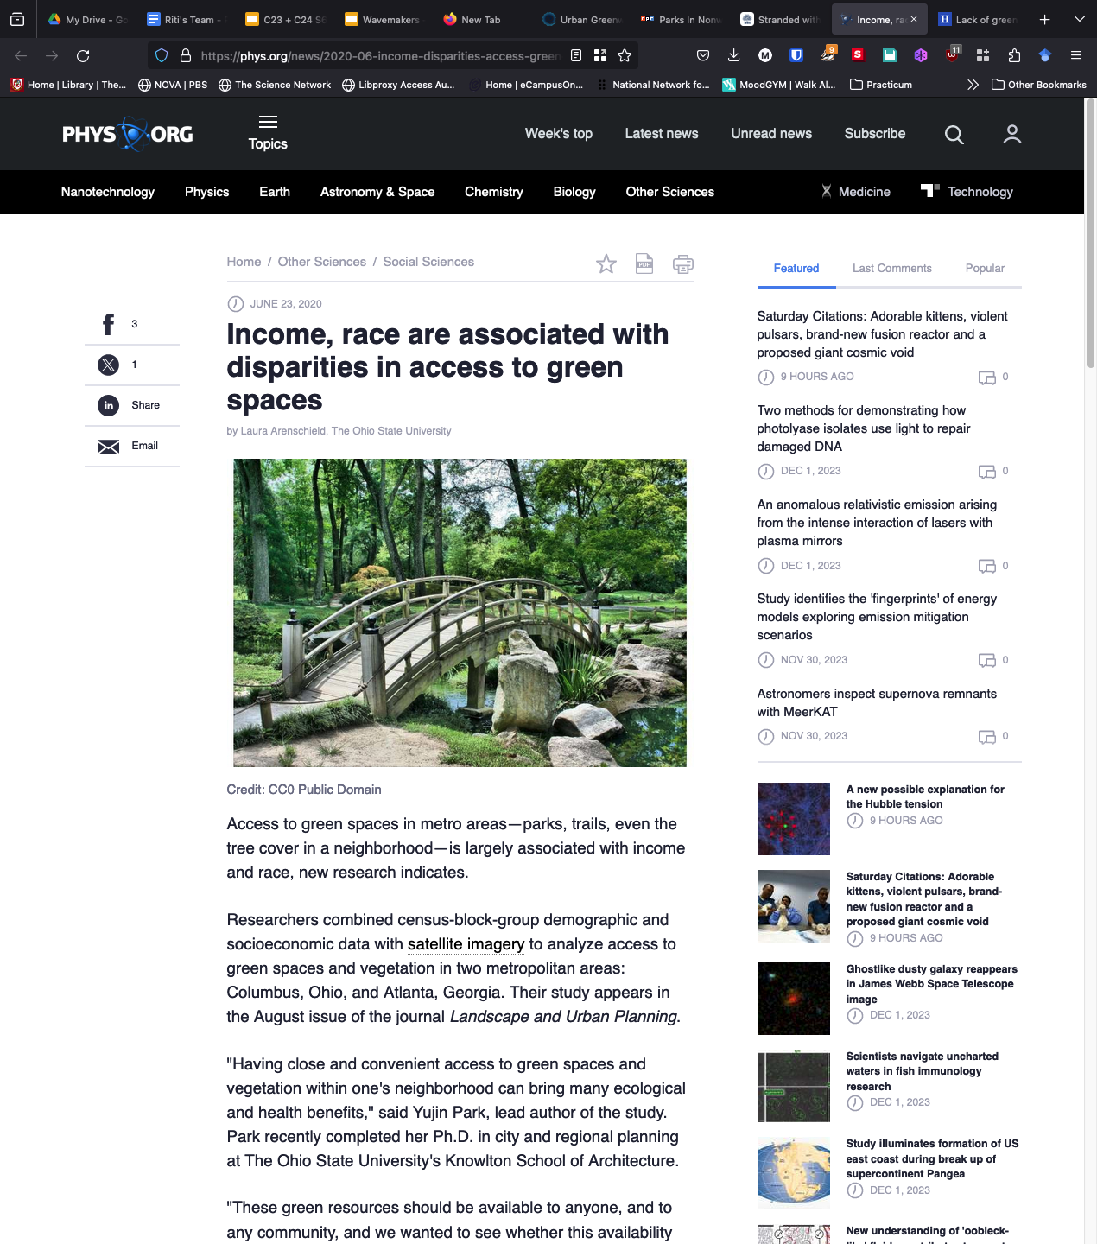
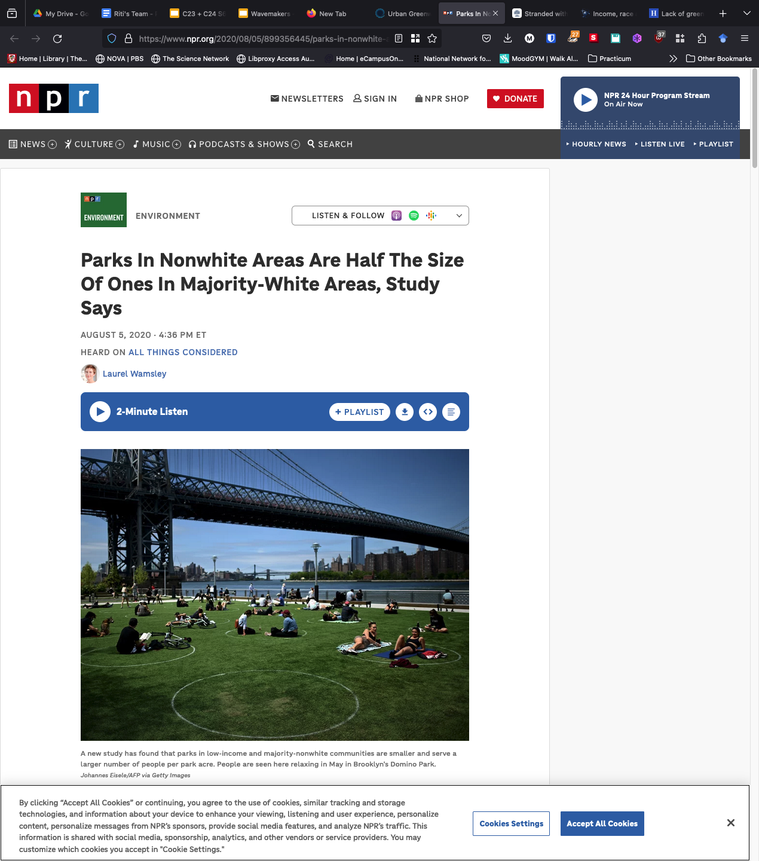
Identify the problem
Notes:
Learning about the following facts helped us identify the problem that we are trying to solve.
Did you know that…
Access to green spaces in metropolitan areas is largely associated with income and race. This finding is supported by research that analyzed access to green spaces in relation to socioeconomic status, income, ethnicity, disability or race.
The influence of income on access to green spaces varies depending on the location. This disparity indicates that affluent neighborhoods and suburbs have greater access to a variety of green spaces, including parks, green lawns, trees, and sports fields.
The lack of equal access to parks for communities of color and low-income areas can be dangerous, especially during public health emergencies like heat waves or the COVID-19 pandemic. Parks offer relief from extreme heat, and areas within a 10-minute walk of a park can be significantly cooler than those beyond that range.
The quality of green spaces of some parks and trees in disadvantaged areas and might not be well-cared-for, making parks unsafe due to poor management. This aspect affects the accessibility and usability of green spaces.
Disabled individuals, particularly in urban areas, are disproportionately burdened by environmental pollution and individual stress. These factors make it crucial for them to have access to suitable environments that cater to their specific needs.
Higher-income and better-educated individuals are reluctant to have park designs and infrastructure fully accommodate the needs of disabled users.

Slide 6
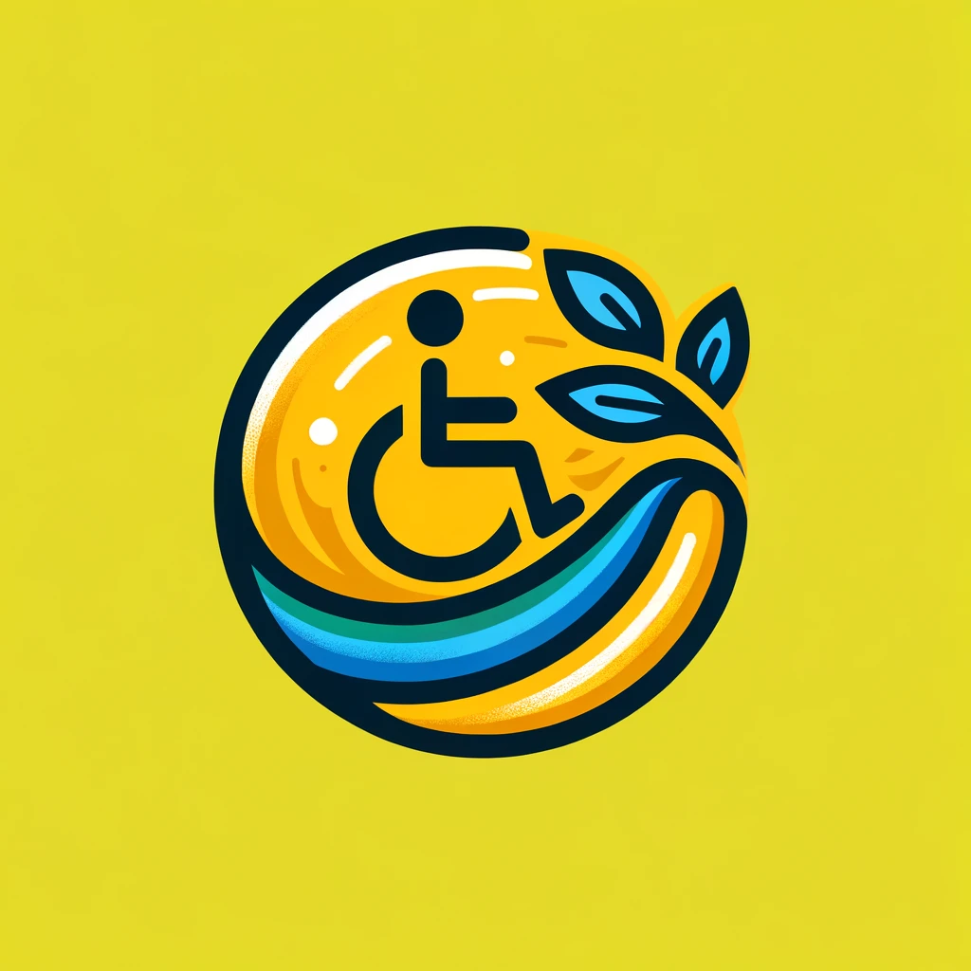
Applying future-proof capabilities
Critical thinking & Active Problem Solving
Innovation & Leadership
Integrating future-proof capabilities
Systems thinking
Resilience
Social & Emotional Learning
Notes:
Our solution not only aims to centre the need for equitable access to urban green spaces for those living with disabilities it also promote awareness for the systemic changes and innovative thinking required to transform our communities to ones that are healthier and more equal in accessing green spaces.
We believe that we have observed critical problem of inequity and lack of access to green spaces in our cities and those living with disabilities in low-income communities are particularly worst affected. We applied critical thinking and active problem solving, both crucial future-proof capabilities, to develop a solution addressing the problem, while having sustainable development goal on good health and well being in mind.
Critical Thinking Skills - The ability to observe, tap into curiosity observation, and approach problems in a systematic and consistent way.
Active Problem Solving - The ability to identify a problem, think of possible solutions, examine the best choice, take action and evaluate if the problem is solved.
Systems Thinking - The ability to holistically view the bigger picture: explore inter-relationships, connections, perspectives, and boundaries on a broad scale and interpret how these relationships interact.
Resilience - The ability to cope with stress and hardship, adversity and uncertainty.
Social & Emotional Learning - The ability to understand and apply the knowledge and attitudes to manage emotions, set and achieve positive goals, feel and show empathy for others, establish and maintain positive relationships, and make responsible decisions.

Slide 7
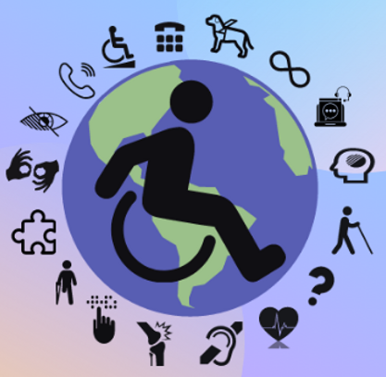
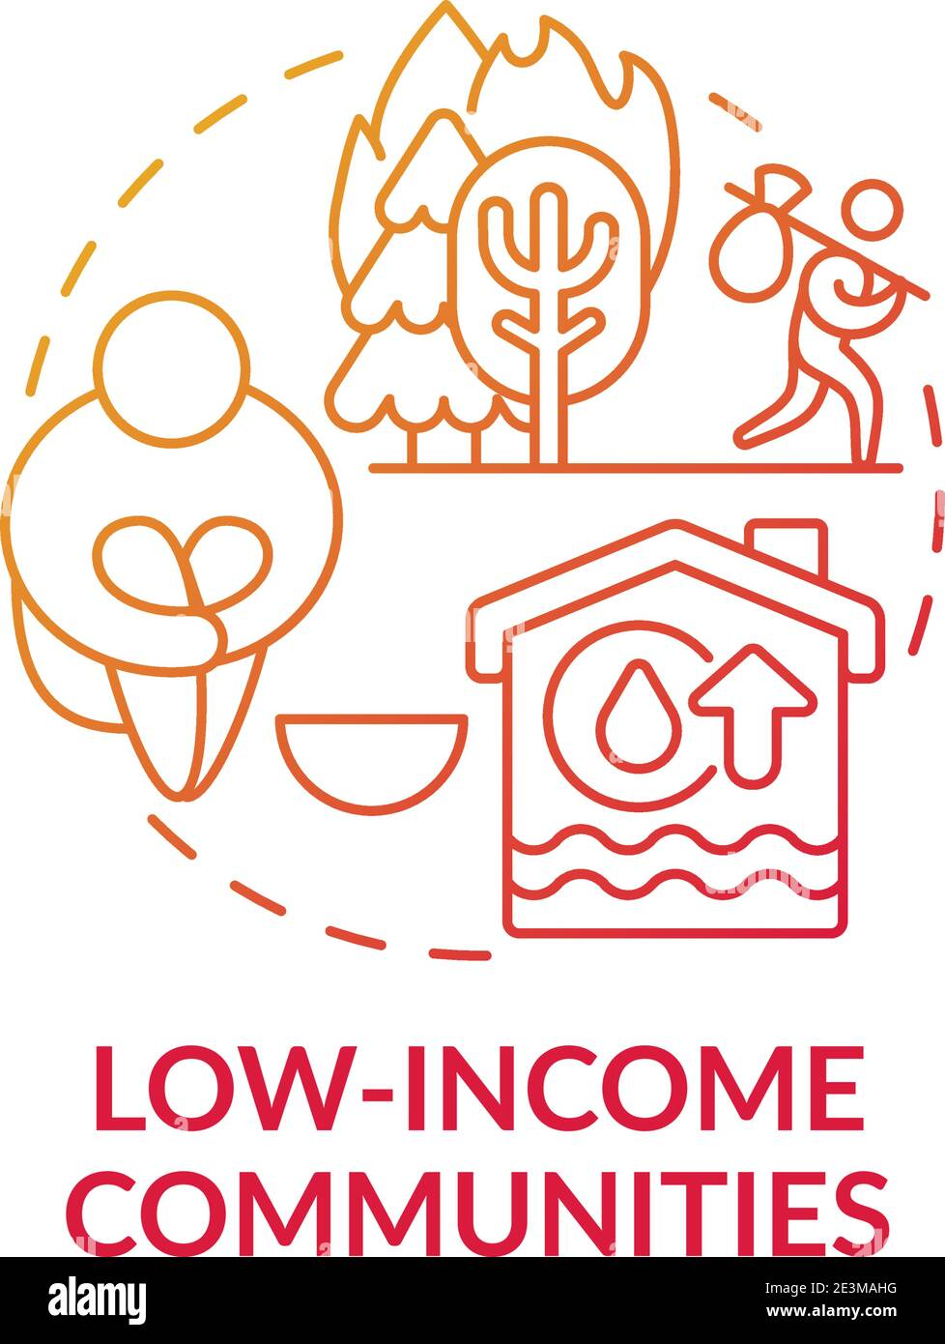
Who are we serving?
People with disabilities in low income communities
Notes:
We are serving people with disabilities in low income communities.

Slide 8
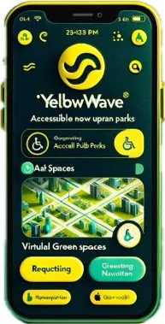
Solution to the Problem
Inclusive Navigation
Virtual Green Spaces
Public Transit Integration
Local community gardens and greenhouses access
Notes:
Show the Solution (2 min) - Explain your prototype solution in clear, simple language and visuals. What do you need to be successful (partnerships, money, sales channels, marketing strategy)? What is the opportunity/impact if things go well?

Slide 9
Solution to the Problem
Inclusive Navigation : the app features an easy-to-use, accessible map with navigation options specifically designed for people with disabilities, ensuring they can comfortably find and access urban green spaces.
Public Transportation Integration : This features can help users easily request affordable bus or train rides to parks and green area. This is especially helpful for people living in areas where it’s not so easy to afford travel
Community Gardens and Greenhouses Access : It shows where you can find gardens and greenhouses in the city. This is great for people who want to grow their own food or just enjoy being around plants and nature.
ASMR Green Spaces : For those who feel stressed or anxious, the app offers soothing nature sounds . it’s like bringing the peaceful feeling of being in a park right to your phone.
Virtual Green Spaces for Limited Mobility : It offers virtual green space experiences for those with limited mobility, ensuring that everyone can enjoy the benefits of nature . like Wavemakers
Notes:
Show the Solution (2 min) - Explain your prototype solution in clear, simple language and visuals. What do you need to be successful (partnerships, money, sales channels, marketing strategy)? What is the opportunity/impact if things go well?

Slide 10



Demonstration of Market fit
Consumer Usage Reasons
Easy navigation and accessible transportation options to green spaces
Target Users
Designed for individuals with disabilities and residents of low-income communities.
Market Necessity
Fills a crucial gap in urban environments for equitable access to nature.
Notes:
Green wave uniquely caters to an often overlooked yet vital need in our communities.
Target users, designed for individuals in low-income communities and those with disabilities, it addresses the challenge of accessing and enjoying urban green spaces.
Consumer Usage Reasons, Users will find Green wave invaluable for its easy navigation to parks, accessible transportation options, and stress-relieving nature soundscapes.
Market Necessity, In today’s fast-paced urban environments, equitable access to green spaces is crucial for physical and mental well-being, fostering a healthier, more inclusive community.
Green wave isn’t just an app, Its a bridge to nature for those who need it most!

Slide 11
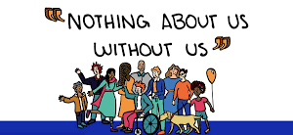




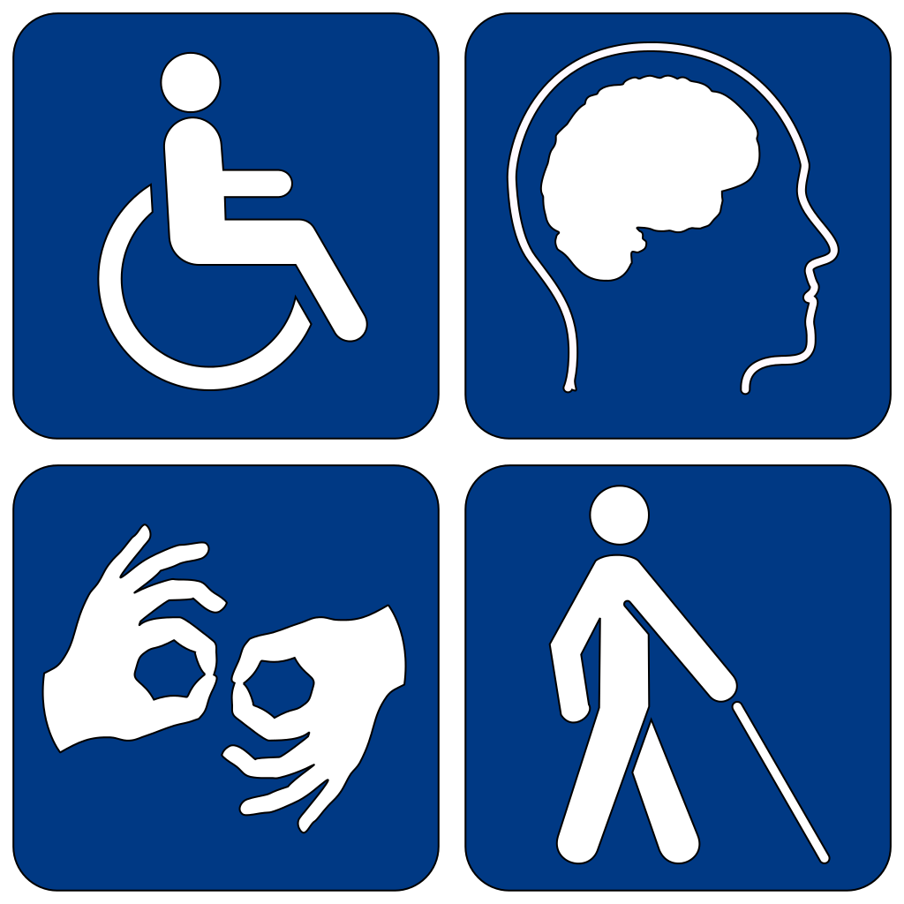


Collaborators
Notes:
Our stakeholders include
“Nothing About Us Without Us” People with disabilities, families and friends,
Provincial health services which include hospitals,
Local community members and local community organizations such as religious organizations,
Government - the federal,provincial and municipal government,
Lastly, insurance providers
We also intend to implement our solution in both Manitoba and Alberta during first few phases of our product launch. We hope to add and develop features as we expand to the national and global level. We anticipate this will take use at least a year to have a global reach once we have collected incorporate the user feedback to expand and improve mobile app features.

Slide 12
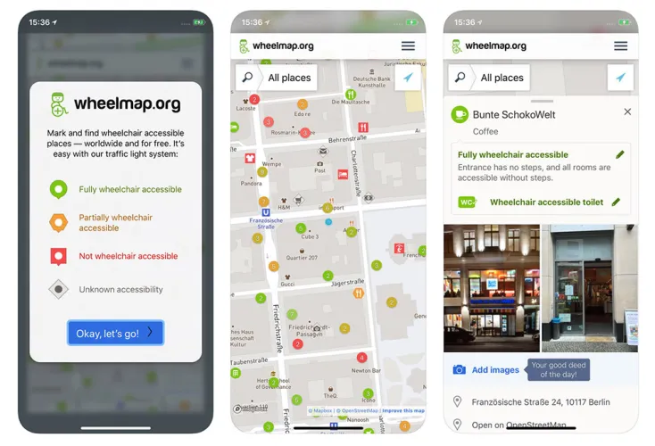
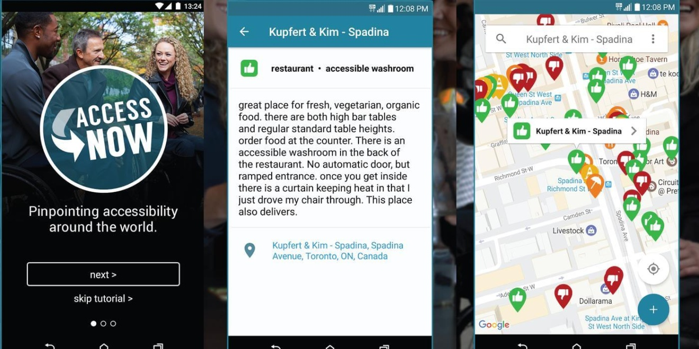
Potential Competitors
Provides wheelchair accessible locations globally. Focused on improving accessibility for those with mobility impairments | Provides information on accessible restaurants, bars, hotels and more on a global map. Allows for community users to rate accessibility of locations.
Neither products offers solutions to making urban green spaces more accessible to people living with disabilities in low-income communities. We aim to support broader part of spectrum of disabilities. Neither applications offer accessible navigation integrated into their map features or virtual green spaces,
Notes:
Identify Competitors and Collaborators (1 min) - What similar products/services already exist? How is your product/service unique/better/disruptive? What opportunities exist to collaborate or partner with others? Why?

Slide 13
Risk Assessment
What could go wrong? | Potential challenges?
Technical Issues Data Security Breaches Inaccurate or Outdated Information Accessibility Shortcomings | Funding and Resource Limitations Market Competition Partnership Dependencies Regulatory Compliance Scalability and Maintenance

Slide 14
What are our community users, partners, and other stakeholders telling us about our product?
Initial thoughts
Suggestions
Quotes
Safety features
Ensure accessible user feedback with rating and surveys
Privacy
Community features - e.g. members rate urban green spaces
Personalization - based on user preferences for urban parks to meditate or do physical activities
“I love the app’s focus on inclusivity, particularly the features catering to people with disabilities. The ASMR green spaces are a unique touch for mental health support.”
“... It’s extremely useful. It provides practical solutions for people in low-income communities to access green spaces, which is often overlooked.”
Empathetic
Inclusive
Impressive
Innovative
Addresses a critical need for more accessible green spaces
Focus on accessibility for all
Notes:
User feedback

Slide 15
Key Metrics for Measuring Success
Number of user downloads
User retention
User ratings and feedback
Achieve 1000 downloads in the first 60 days.
Achieve 5000 downloads after the first 6 months
Retain about 60 to 70 percent of users who have downloaded the app and registered for at least the first 6 months.
Achieve 4-5 app rating stars.
Collect optional user experience survey for at least 10 percent of users (providing gift incentives).
Notes:
How are we measuring success?

Slide 16
Product Road Map
Phase 3 - Full Launch : National and Global Rollout
Nationally and globally release mobile app
New Feature Rollout
Collaboration with National and Global Partners
KPI Tracking and User Analytics
Feedback Loop and Continuous Improvement
Phase 1 - Soft launch
Release mobile app to variou platforms (e.g. apple, google, windsor, etc)
Soft launch with collaborators and community partners with limited features
Q1, 2024
Q3, 2024
Q4, 2023
Q2, 2024
Phase 2 - Expanded Launch
Add more features (e.g. virtual green spaces,
Regional release of application in the prairies, aiming for national launch - including Manitoba and Alberta accessible urban parks virtually mapped with accessible navigation feature running.
Collect KPI to improve app user experience
Phase 4 - Evaluation and Growth
Performance Review
User Feedback Collection
Feature Optimization and Updates
Market Analysis
Future Feature Planning
Sustainability and Social Impact Assessment
Long-term Strategy Development
Notes:
Product Road Map (1-1.5 min) - Explain your steps for implementation via a visual timeline

Slide 17
Thank you! Any questions?

Slide 18
References
https://www.earthisland.org/journal/index.php/articles/entry/urban-greenways-need-to-be-made-more-accessible/https://www.earthisland.org/journal/index.php/articles/entry/urban-greenways-need-to-be-made-more-accessible/
https://www.npr.org/2020/08/05/899356445/parks-in-nonwhite-areas-are-half-the-size-of-ones-in-majority-white-areas-study-https://www.npr.org/2020/08/05/899356445/parks-in-nonwhite-areas-are-half-the-size-of-ones-in-majority-white-areas-study-
https://phys.org/news/2020-06-income-disparities-access-green-spaces.html
https://www.trend-able.com/25-life-changing-apps-for-people-with-disabilities/\
https://www.sciencedirect.com/science/article/pii/S1618866706000288

